Slide 1
Library Management System (lms)
WEB BASED E- BOOK LISTING SYSTEM
By
Agnes N Vernencia
Gayathri P J
Harshitha Priyadarshini K
Janalakshmi M
Jency Freeda J
Manaswini D

Slide 2
OBJECTIVE:
LMS IS AN ONLINE PORTAL WHICH MAINTAINS THE RECORD OF BOOKS IN THE LIBRARY IN E-FORMAT AND LISTS ALL THE E-BOOKS WHICH CAN BE DOWNLOADED THROUGH THE STUDENTS PORTAL.
USERS OF THE SYSTEM:
1.Admin
2.Customer

Slide 3
FUNCTIONAL REQUIREMENTS:
The Library Management System must have the following functional requirements:
The LMS should store all information about librarian and other users (students and faculty members) – their login info, E-books etc.
The LMS should store all information about the E-books and users in two separated databases (SQL).
The LMS should allow searching books/journals by author, title, keywords or availability.
The LMS should provide modules to search, request and renew books.

Slide 4
The librarian must be able to add/remove books, manage users, process dues, view recommendations from users, etc.
This is an application built for customers to access E-books in library online.
It deals with the process of managing data about the E-books in the library.
The system deals with the all the requirements needed for managing the library.
In this project we created the computer based Library Management System.

Slide 5
NON-FUNCTIONAL REQUIREMENTS:
Usability Requirements
The user interface should be interactive, simple and easy to understand. The system should prompt for the user and administrator to login to the application for proper input criteria.
Error Handling
Library management system shall handle expected and non-expected errors in ways that prevent loss in information and long downtime period.

Slide 6
Security Requirements
The LMS should provide databases’ modification only for the librarian after proper authorization.
The system shall accommodate high number of books and users without any fault.
Reliability Requirements
The system should accurately performs member registration ,member validation , report generation, book transaction and search.

Slide 7
Software Requirements
Database - MYSQL is used as database as it easy to maintain and retrieve records by simple queries which are in English language which are easy to understand and easy to write.
Development tools and Programming language - HTML is used to write the whole code and develop webpage with CSS which is used to give styles for the webpage.
php as server side scripting language which will be used for database connectivity.

Slide 8
Hardware Requirements
Intel core i3 and above is required for a stable experience and fast retrieval of data.
2 GB RAM is required as it will provide fast reading and writing capabilities which will in turn result in better performance time.
Browser Compatible
All latest browsers are compatible to use this portal.

Slide 9
Technology Stack:
Front End: HTML,CSS
Material Design: Bootstrap
Server Side: Xampp Server, Php Myadmin
Database: MySQL

Slide 10
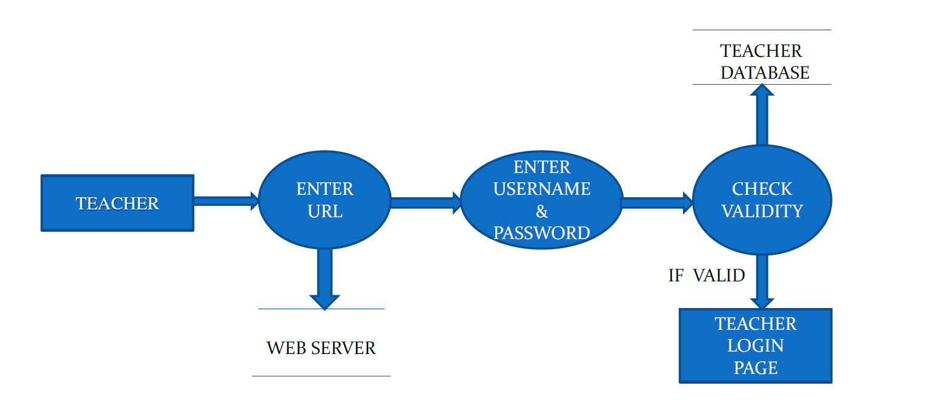
DATA FLOW DIAGRAMS:
DATA FLOW DIAGRAM FOR TEACHER LOGIN

Slide 11
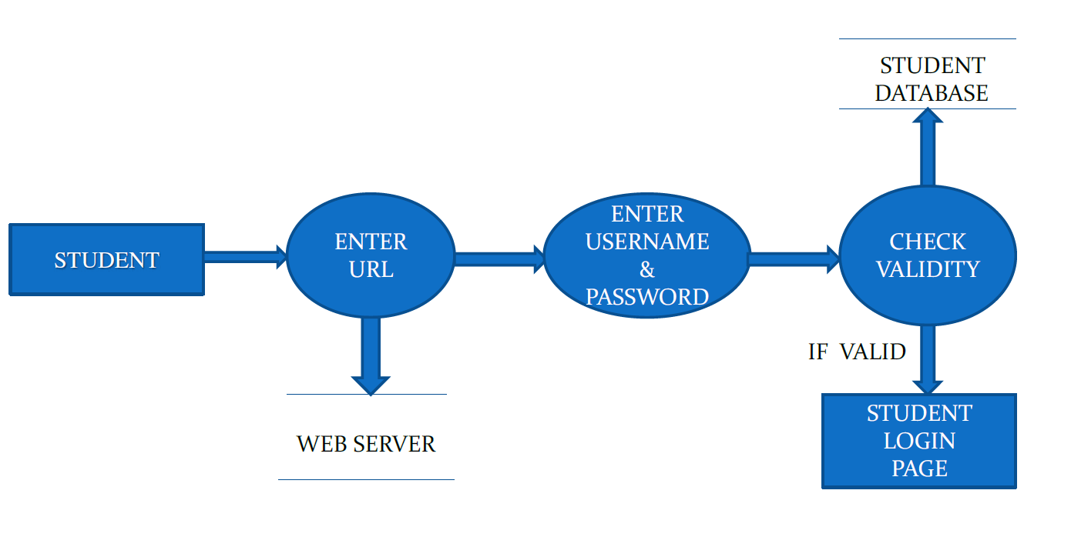
DATA FLOW DIAGRAM FOR STUDENT LOGIN

Slide 12
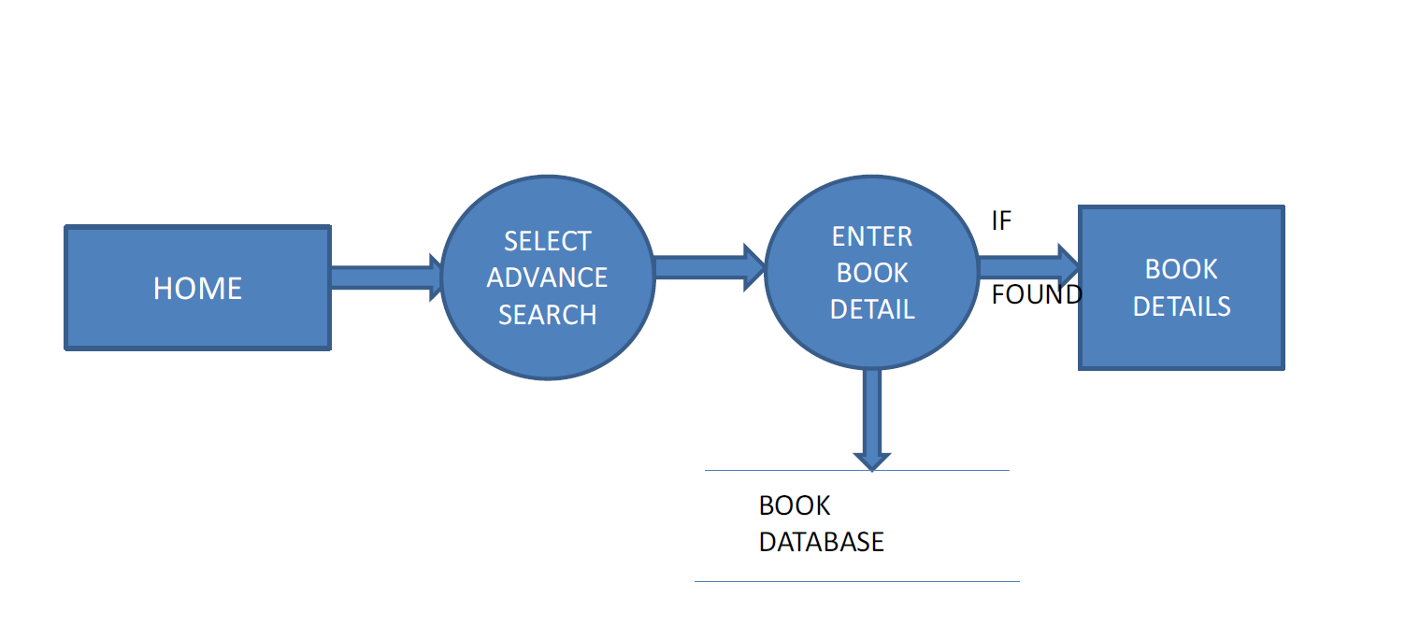
DATA FLOW DIAGRAM FOR BOOK SEARCH

Slide 13
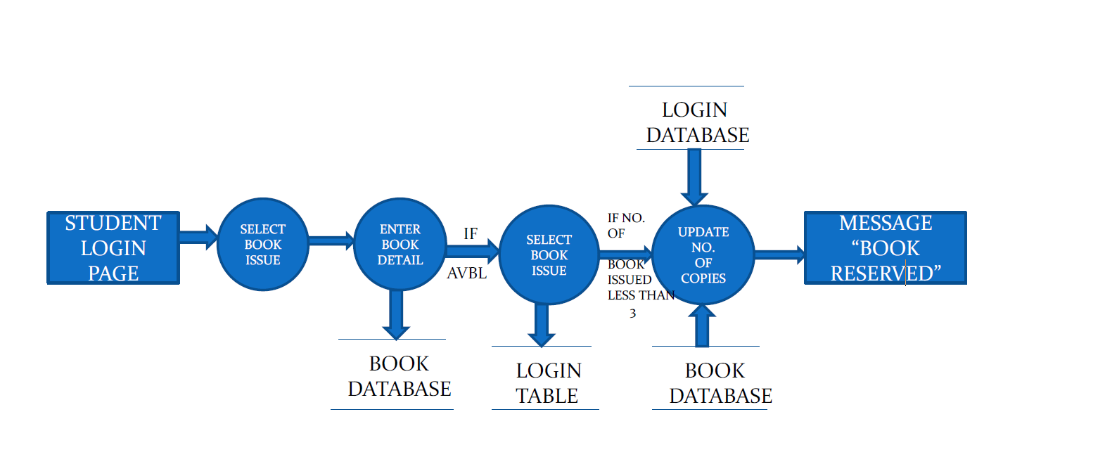
DATA FLOW DIAGRAM FOR BOOK ISSUE

Slide 14
CONTROL FLOW DIAGRAM:

Slide 15
Thank You

